Slide 1



SUSTAINABILITY
HACKBOX
stefan
Sustainability Use Case Automotive Emissions Reporting and Energy Performance Management
#GRI305 #GRI302 #SASB #SBTi #MicrosoftCloudForSustainability #MCfS #MicrosoftSustainabilityManager #MSM
#Data #PowerPlatform #PowerBI #Teams 2023/02/26
alex

Slide 2

Agenda
Customer’s Sustainability Challenge
Sustainability Hack Approach
Demo: Microsoft Sustainability Manager & Customizations
Home
Simple Data Import
GRI Emissions Report
Emissions Scope 2 – Activities
Energy Report
Energy Targets & Performance Management
Demo: Team Collaboration on Sustainability Data
Sharing reports in Teams channels
Chatting related to reports
Data entry in private Teams channel

Slide 3

Sustainability Report 2021
AUTOMOTIVE
CO2 neutral by 2030 – driving for a carbon free world
SUSTAINABILITY CATEGORIES | METRICS | UNIT OF MEASURE | 2021 DATA
GHG Emissions | Scope 1 & 2 emissions | Metric Tons (t) CO2e | 670.1 mt
Energy Management | Aggregate amount of energy consumed | MegaWatt hours (MWh) | 164,340 MWh
 | % of energy consumed that is renewable energy | Percentage (%) | 11%
 | Energy intensity | MegaWatt hours (MWh) / Sales (USDm) | 25 MWh/m$
 | Energy intensity reduction target | MegaWatt hours (MWh) / Sales (USDm) | ≥2% p.a.
ENERGY ACCOUNTING METRIC | 2019 | 2020 | 2021
Aggregate amount of energy consumed | 167,568 MWh | 165,183 MWh | 164,340 MWh
Percentage of energy consumed that is renewable energy | NA | NA | 11%
Energy Intensity (MWh/Sales (m$)) | 28 MWh/m$ | 26 MWh/m$ | 25 MWh/m$
EMISSIONS ACCOUNTING METRIC | 2019 | 2020 | 2021
Scope 1 & 2 emissions (metric tons) | 807.6 mt | 782.7 mt | 670.1 mt
Revenue (USD, millions) | 2768.3 m$ | 2907.2 m$ | 3,801.5 m$
Revenue Intensity (CO2 metric tons/m$ Revenue) | 0.291731387 | 0.269228123 | 0.176272524

Slide 4
Sustainability Report 2021
AUTOMOTIVE
Contoso Automotive Group
Contoso Powertrain
Contoso Mirrors
Contoso Electronics
Contoso Fuel Cells
Contoso Seating
Contoso Exteriors
Contoso Lighting
Contoso Mechatronics
Contoso Vehicle Manufacturing

Slide 5
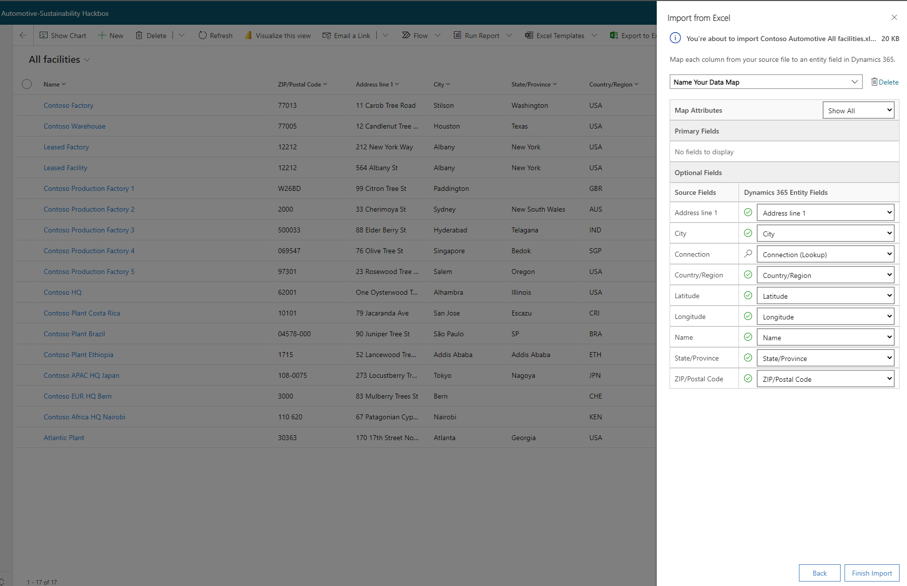
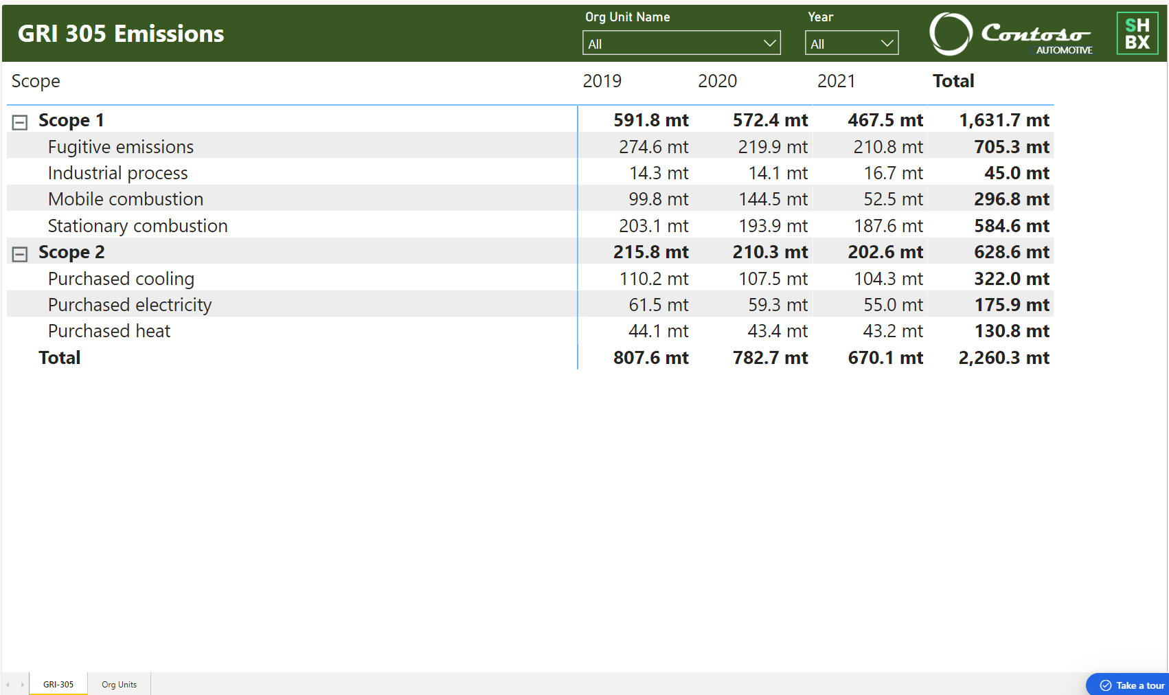
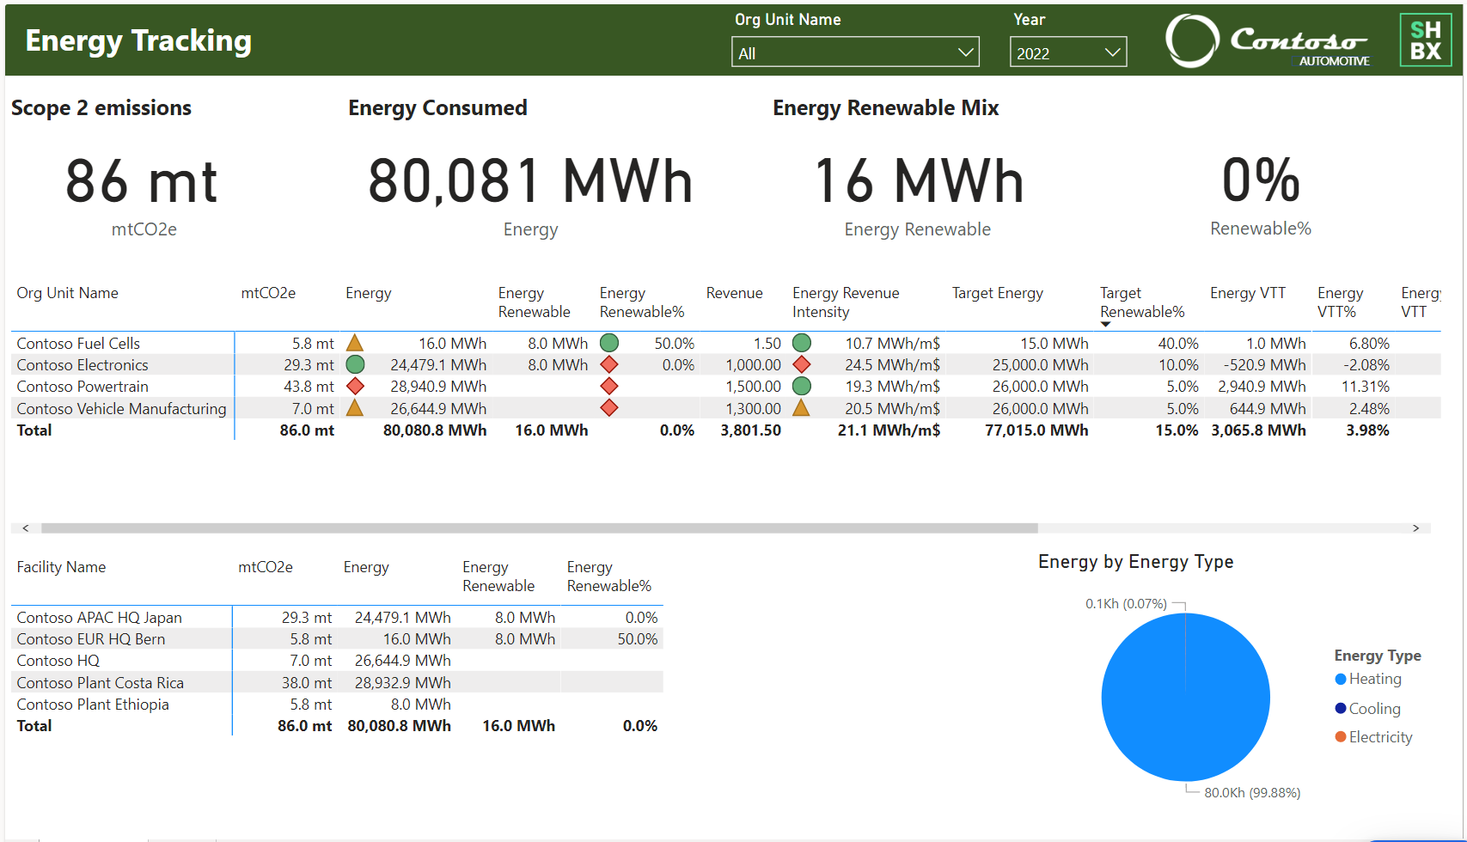
Sustainability Hack Approach
Can we drive Energy accountability for Group Leaders by setting targets and introducing performance management?
Can MCfS replace the existing Sustainability Reporting?
Can we easily import existing org structure and “flat” sustainability data?
Connect your data and calculate your impact
View data analysis and insights
Take action to accelerate your sustainability journey
Proof tangible use cases in 3 weeks

Slide 6
SUSTAINABILITY
HACKBOX
Youtube
Github
LinkedIn
https://www.youtube.com/@shbxio
https://github.com/shbxio
http://bit.ly/shbxio

